Slide 1

2072 – Project 1 Genotype QC
Maleah Benn
Feb. 17, 2022

Slide 2
The Dataset
The dataset is split into two main components:
SNP-level information:
3,300 SNPs
6 chromosomes
Autosomes: 21, 22, 23
Sex chromosomes: X (24), Y (25)
Mitochondrial chromosome: 26
Sample-level information:
77 samples
42 male; 35 female
49 CEU; 28 YRI
43 unique subjects
13 families
Notes:
HapMap population group abbreviations used where ‘CEU’ designates Utah residents with Northern and Western European ancestry and ‘YRI’ designates Yoruban individuals in Ibadan, Nigeria.

Slide 3
Missingness
Round 1
Round 2
Filter out SNPs with 100% MCR
151 SNPs excluded (3,149 retained)
Filter out SNPs with ≥5% missingness
54 SNPs excluded (3,095 retained)
Filter out samples with ≥5% missingness
0 samples excluded (77 retained)
Filter out samples with ≥5% missingness
0 samples excluded (77 retained)
Notes:
Table of exclusion snpIDs and scanIDs can be provided upon request.

Slide 4
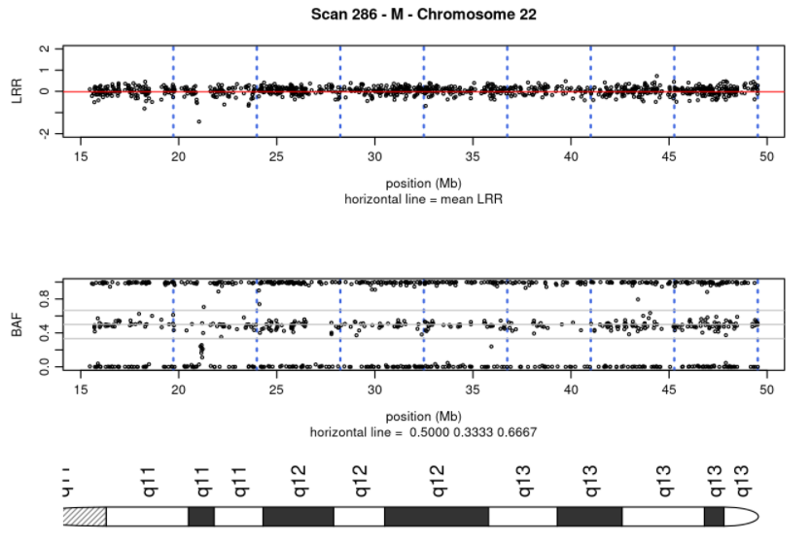
Allelic Imbalance
1 sample (scanID 286) flagged for potential anomaly
Notes:
From the BAF plot for sample 286 chromosome 22, it looks like there are a few small LOH runs; one from ~26-27 Mb, ~37-38 Mb, ~45 Mb, and ~49 Mb. In these areas there are still data points at both 0.0 and 1.0, but no points near the 0.5 band, indicating a loss of heterozygosity. Additionally, when looking at these same areas of the chromosome on the LRR plot, we do not see any shift in intensity. If the LRR had shifted down, that would indicate a deletion as opposed to a LOH. However, the LRR remains near 0.0, supporting the LOH theory. Additionally, near the 22 Mb mark, there is a gap in the LRR plot and a corresponding lack of clustering at the same position in the BAF. Maybe this is due to bad probes in this area of the chromosome.

Slide 5
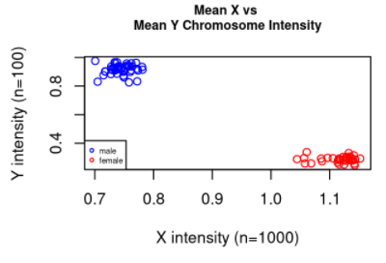
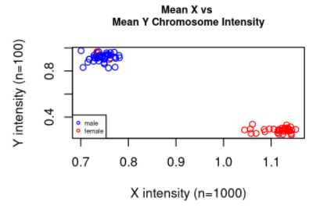
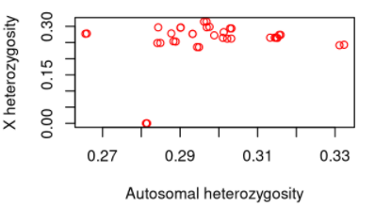
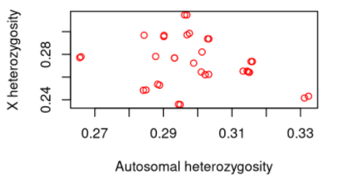
Sex Discrepancies
Notes:
(left plot) There are a few samples (maybe 2) that have a discordance between reported and inferred sex. The data points are colored by reported sex but plotted based on inferred. There are two data points that are colored red (indicating a reported sex of female) while clustering with the male inferred sex. This is consistent across the four chromosome intensity and heterogeneity plots.
(right plot) Additionally, there appears to be two outliers near the 0.0 X heterozygosity position on this plot which may be indicative of an individual who is XY or XO (inferred) but reported a sex of ‘female’ (biologically, XX). This could be a reporting error or an identity discordance.
(narrative) ScanIDs 325 and 326 are discordant where the reported sex (F) does not align with their X heterozygosity calculations. Individuals who are biologically female (XX) will have a higher X heterozygosity than biologically male (XY) individuals. Therefore, scanIDs whose sex is recorded as “F” but whose X heterozygosity is less than 5% are likely discordant. Additionally, scanIDs 325 and 326 are listed as being the father of scanIDs 294 and 295. This pedigree information confirms that the reported sex of ‘female’ was erroneous. The updated plots are shown below.
(recommended follow up) To follow up on sex discordance, first check to see if the reported sex was entered in error. Confirm with the person who entered in the data and use other documentation to see what reported sex is listed for discordant samples. Additionally, I would check with pedigree information to see if the discordance can be resolved. If the reported sex discrepancy cannot be resolved via additional documentation, the sample should be excluded from downstream analyses.

Slide 6
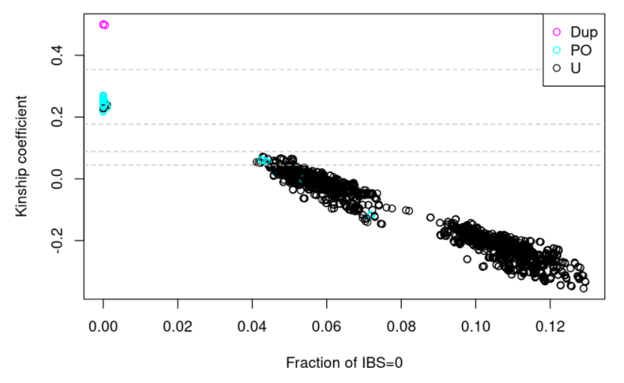
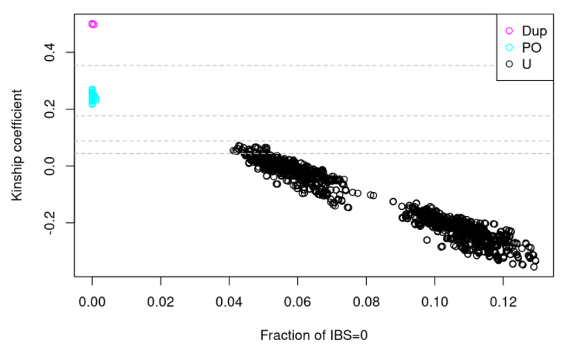
Relatedness Discrepancies
scanID | Incorrect Family ID | Incorrect Father ID | Incorrect Mother ID | Corrected Family ID | Corrected Father ID | Corrected Mother ID
296 | 1344 | 200116780 | 200005043 | 1334 | 200118596 | 200019634
297 | 1344 | 200116780 | 200005043 | 1334 | 200118596 | 200019634
298 | 1334 | 200118596 | 200019634 | 1344 | 200116780 | 200005043
299 | 1334 | 200118596 | 200019634 | 1344 | 200116780 | 200005043
Notes:
From the kinship plot, we see there are some inconsistencies between the expected and observed genetic relatedness statistics. 16 pairs that are supposedly unrelated are actually parent-offspring pairs; and 17 pairs that are supposedly parent-offspring pairs are showing up as genetically unrelated. Each of the 33 discrepancies is a ‘dot’ in the ‘wrong cluster’ in the IBD plot we drew.
Three families were identified as being involved in the discrepancies: 58, 1334, 1344 where family 58 accounts for 1 discrepancy and the remaining 32 come from families 1334 and 1344.
(family 58) It appears the discrepancy is due to a case of non-paternity - the pedigree in scanAnnot says that 356 is 355’s father, but the kinship calculation says they’re genetically unrelated. The family ID was updated from 58 to 58-2 for both scans to reflect the inferred relationship of unrelated.
(families 1334 and 1344): It appears that the children of these trios had a sample swap. The family IDs, mother IDs, and father IDs were manually corrected.

Slide 7
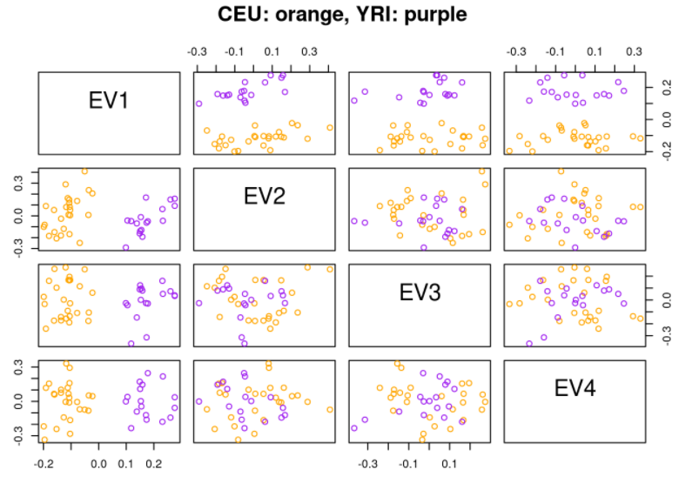
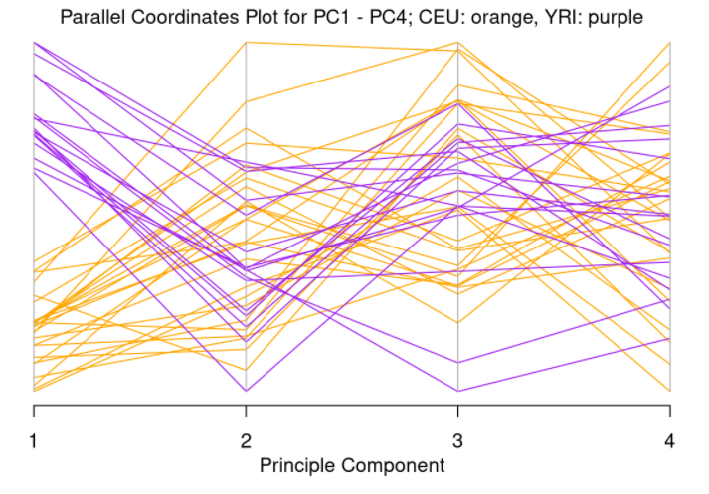
Population Substructure
3,300 SNPs
LD pruning
182 SNPs
PCA
77 samples
Remove duplicates
43 samples
PCA
Notes:
Of the 3,300 SNPs in the dataset, 3,118 were excluded from PCA analysis where sex chromosomes and SNPs in high LD were removed. Of the 77 samples in the dataset, only duplicates were removed, leaving 43 unique subjects in the PCA analysis. Typically, we’d remove non-founders as well (offspring of other subjects in the study), but they were left in for this analysis due to small sample size.
(pairwise) The pairwise plot shows clear separation between CEU (orange dots) and YRI (purple dots) for EV1. However, the remaining PCs don’t show this same level of clustering.
(parallel coordinates) Again, on the parallel coordinates plot, we see a clear distinction between YRI and CEU at PC1, but not so much on the other PCs. This is to be expected as the first PC captures the majority of the variance, while subsequent PCs capture less and less variance.

Slide 8
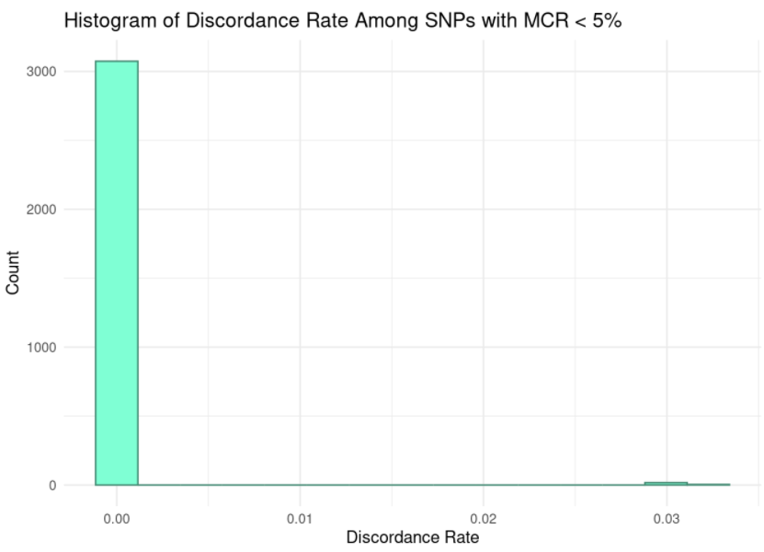
Duplicate Sample Discordance
34 duplicates
25 discordances
Applied threshold of ≥1 discordance
Error rate < 10⁻³
21 SNPs excluded
3,074 SNPs retained
Notes:
34 subjects had duplicate measures where 25 of the subjects had at least one discordant duplicate pair. The maximum number of discordances per subject was 2, with a median discordance rate of 3%.
A discordance rate threshold of >= 1 discordant calls was implemented as this threshold retains >99% of SNPs with an error rate < 10^-3 while removing 14.8% of SNPs with an error rate > 10^-2. This threshold eliminates 21 SNPs. There are 3,300 total SNPs in the dataset. After filtering out 205 SNPs where missing.n2 was 5% or higher, there are 3,095 SNPs remaining. Of the remaining 3,095 SNPs, 21 fail the discordance threshold of >= 1, leaving 3,074 SNPs remaining for downstream analyses. A histogram of the remaining SNPs is shown below.

Slide 9
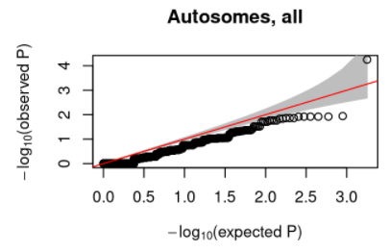
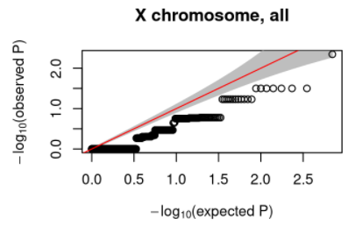
HWE Testing
snpID 1015218
*P = 5.62e⁻⁵
77 samples
Remove duplicates
43 samples
Remove founders
17 samples
HWE testing
snpID 1056077
P = 4.5e⁻³
* Indicates significant HWE p value above threshold of 1.0e⁻⁴
Notes:
HWE testing allows you to investigate probe quality. Any probes that deviate significantly from HWE expectations should be removed from analyses unless they are significantly out of HWE due to a truly significant association with your phenotype of interest. HWE testing should be conducted on subjects that are not duplicates and that are founders. Since HWE is sensitive population substructure, HWE testing should only be conducted within each race stratum. In this case, there were 60 subjects (26 founders plus 34 duplicates) removed, leaving 17 included in HWE testing from the original 77 subjects in the dataset.
The qqplots for autosomal SNPs show one SNP that has a very small p-value. This could be due to true, significant association with the phenotype, or it could be that the SNP is out of HWE. This SNP (snpID 1015218) shows a p-value of 5.62x10^-5.
The X chromosome qqplots also have one potential outlier. This SNP (snpID 1056077) has a p-value of 4.5x10^-3. It is unlikely that this SNP is out of HWE as it does not meet the suggested HWE threshold of 1.0x10^-4.
The threshold for p-value will be 1.0x10^-4. After filtering by this p-value threshold, only 1 SNP is removed (snpID = 1015218) from those with low missingness leaving 3,073 SNPs remaining in the analyses.

Slide 10
The Cleaned Dataset
3,300 SNPs
Missing
check
3,095
Allelic Imbalance
3,095
Sex check, relatedness, PCA
3,074
3,073 SNPs
HWE testing
Downstream analyses
Notes:
A total of 3,073 SNPs from 77 samples are now ready for downstream analyses.

